Slide 1



Blockchain-Based Criminal Information Management System in Sri Lanka
GROUP ID: 23-270

Slide 2
Table of Contents
01
02
03
Overall Project Description
Smart Contract for Blockchain
Authentication System
IT20150952
IT20171438
04
05
Secure File Management System
Chain of Custody
IT20157814
IT19983370

Slide 3




Group Members
IT 20150952
Brahanawardhan B.
IT 20171438
Wijayarathne S.N.
IT 20157814
Ahamed M.N.H.
IT 19983370
Thushitharan M.
Project Details
Project ID: 23-270
Supervisor: Mr. Kanishka Yapa
Co-Supervisor: Ms. Dinithi Pandithage

Slide 4

Overall Project Description
01

Slide 5

Introduction
This project aims to develop a blockchain-based criminal information management system as an improvement of the existing criminal information management method in Sri Lankan.
Why we need blockchain technology ?
It helps improve data security, transparency and efficiency in managing criminal records

Slide 6

Introduction
Who will get benefits from Blockchain based Criminal Information management system ?
Law Enforcement Authorities
Police Officers
Lawyers
Police Departments
Law Enforcement Agencies

Slide 7
Research Question
How can a blockchain-based criminal information management system be implemented effectively in Sri Lanka to enhance data security, transparency, and efficiency in the criminal system ?
Understand the Current policy and procedure of Criminal System in Sri Lanka.
Identify the Stakeholders
Define the System Requirements
Develop a Blockchain platform

Slide 8
Research Problem
Objectives
Lack of integration
Inconsistent data quality
Privacy and security concern
Insufficient process
SMART CONTRACT
AUTHENTICATION SYSTEM
INTERPLANETARY FILE SYSTEM
CHAIN OF CUSTODY
| Deployment of Criminal Records in blockchain
| Prevent from the Unauthorized access
| To Secure Store criminal Evidence Document
| High level of security for records verification

Slide 9
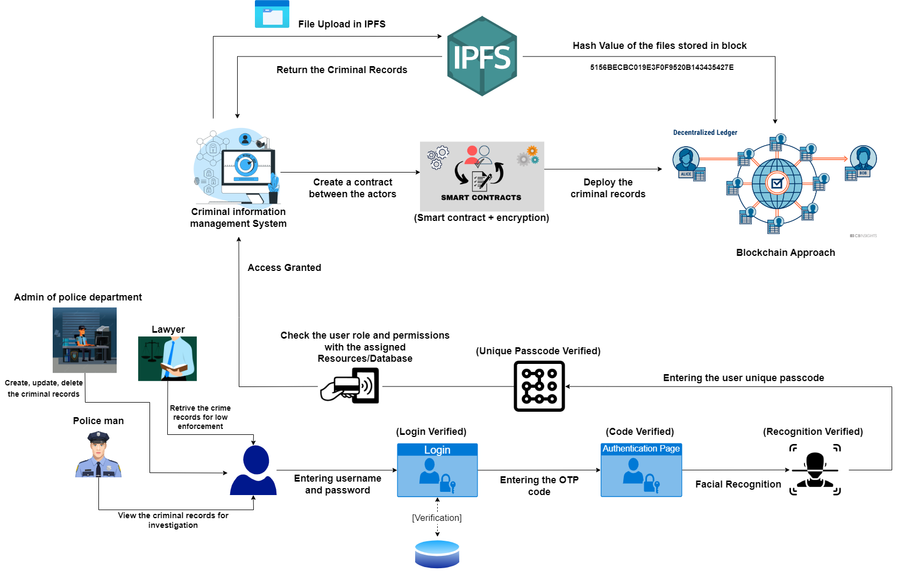
Overall System Diagram

Slide 10
Implementing Smart Contract For Blockchain
02
IT20150952 | BRAHANAWARDHAN B.
BSc (Hons) in Information Technology Specializing in Cyber Security

Slide 11

Sub Objective
Implementing Blockchain network for Criminal information Management System using Smart Contracts
IT 20150952 | [Brahanawardhan]

Slide 12

Research Problem
How to ensure the Confidentiality, Integrity, Availability of Criminal records ?
Challenges currently encountered by the Criminal information management System ?
Interoperability
Scattered Criminal Records
Handfill Documents
Integrity problem
Local databases
IT 20150952 | [Brahanawardhan]

Slide 13

Objectives Achieved
Increased efficiency, transparency, and Security
Ensured Confidentiality, Integrity, Availability
Reduced the lack of Consistency
Increased the performance and usability of Criminal Records.
IT 20150952 | [Brahanawardhan]

Slide 14

Risk & Solution
Risks
Data Privacy Concerns
Immutable Records
Regulatory Compliance : GDPR, HIPAA
Solution
Smart Contracts for Data Management.
Regular Audits and Monitoring.
IT 20150952 | [Brahanawardhan]
Notes:
Data Privacy Concerns: Storing sensitive criminal information on a blockchain raises concerns about data privacy and confidentiality. If not properly implemented, unauthorized access to this information can compromise individuals' rights and safety.

Slide 15
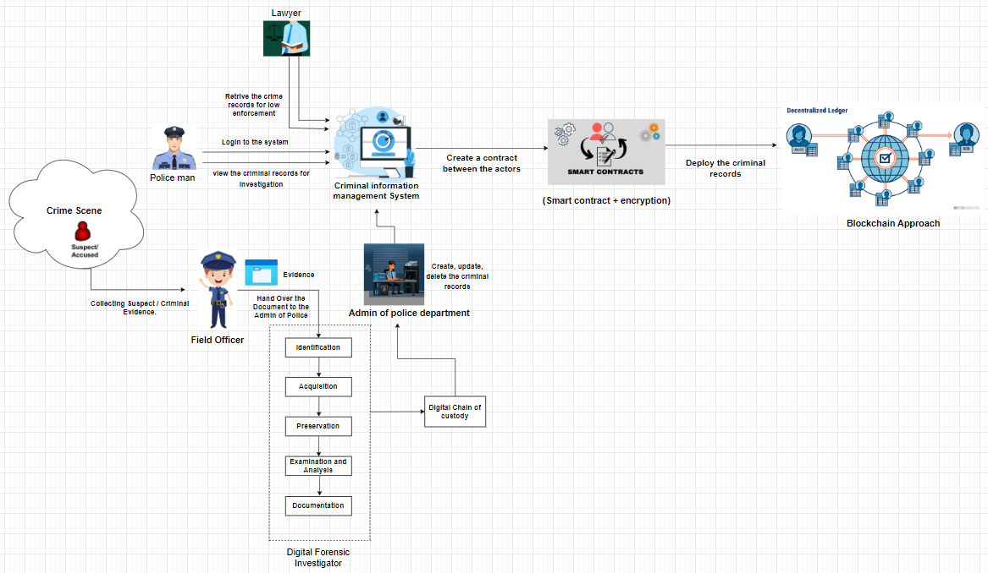
System diagram and possible solution

Slide 16
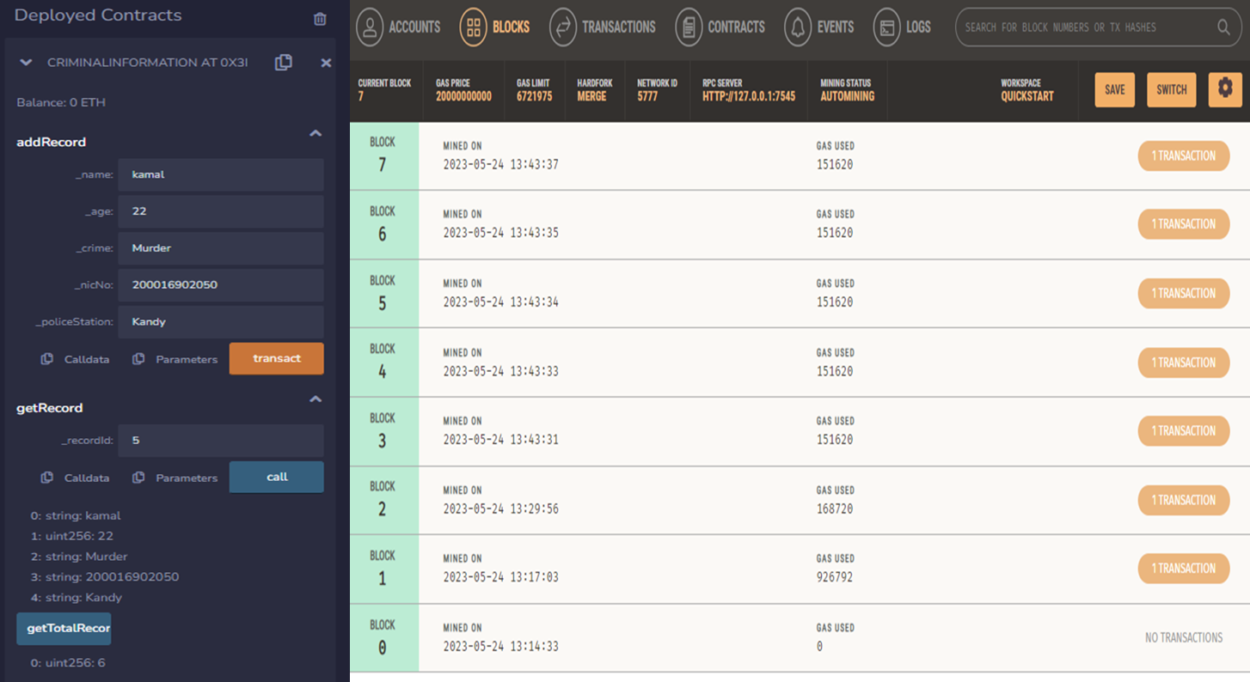
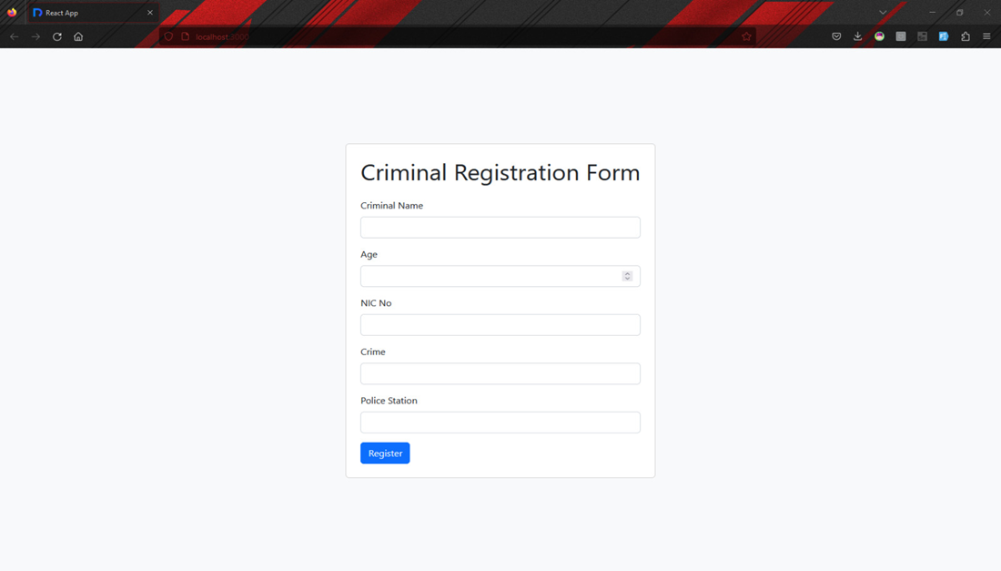
Progress up to Progress presentation - 01
IT 20150952 | [Brahanawardhan]

Slide 17
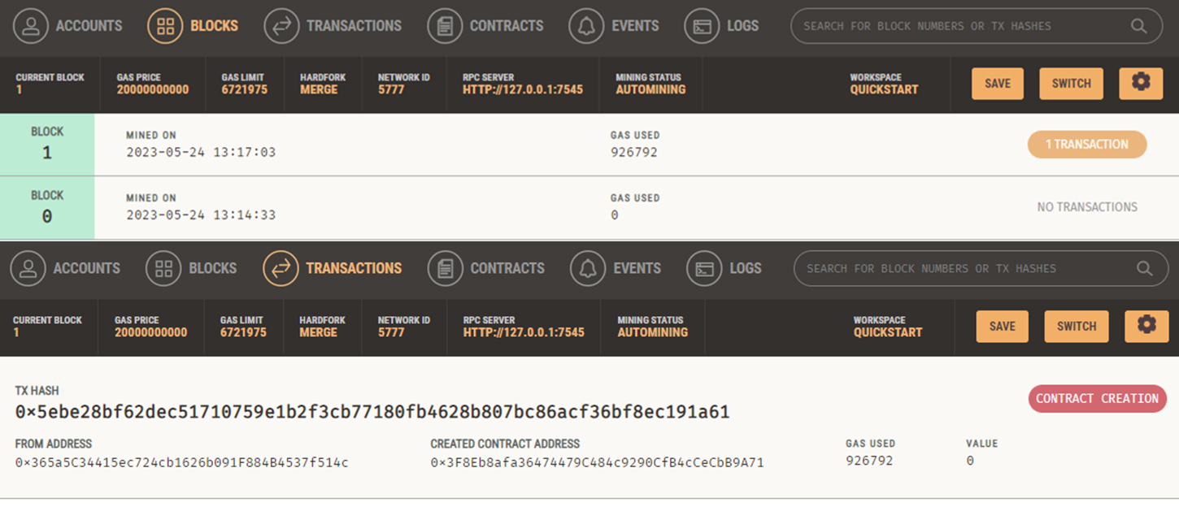
Progress up to Progress presentation - 01
IT 20150952 | [Brahanawardhan]

Slide 18
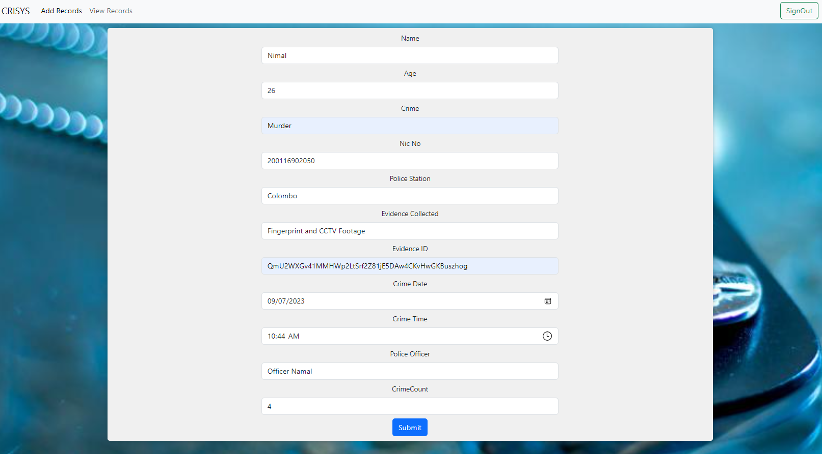
Progress up to Progress presentation - 02
IT 20150952 | [Brahanawardhan]

Slide 19
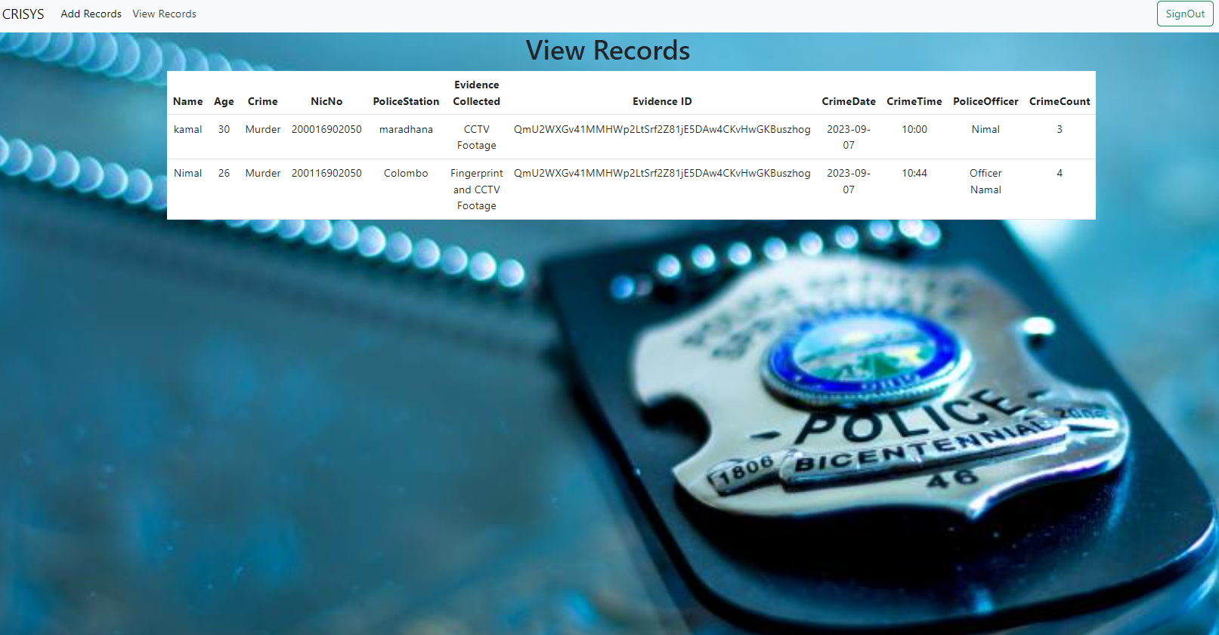
Progress up to Progress presentation - 02
IT 20150952 | [Brahanawardhan]

Slide 20
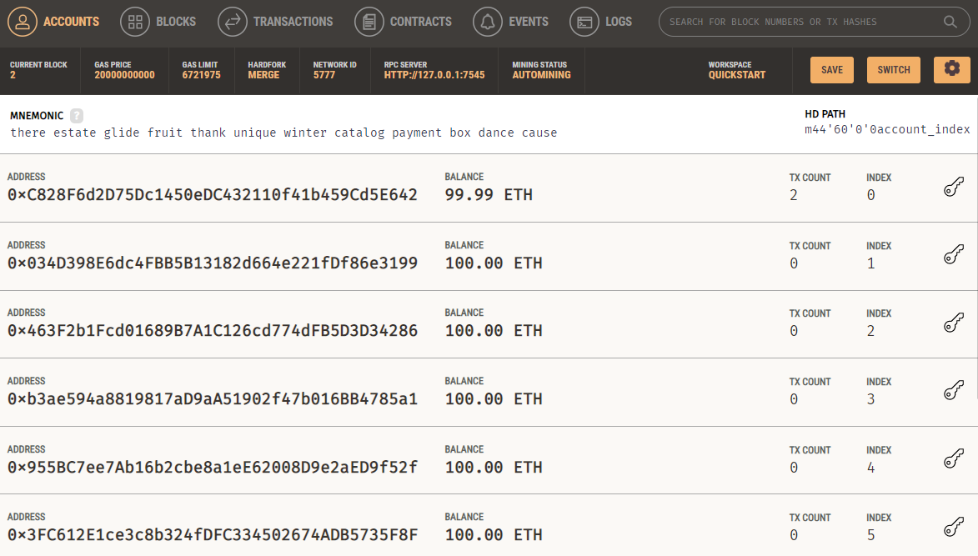
Progress up to Progress presentation - 02
IT 20150952 | [Brahanawardhan]

Slide 21
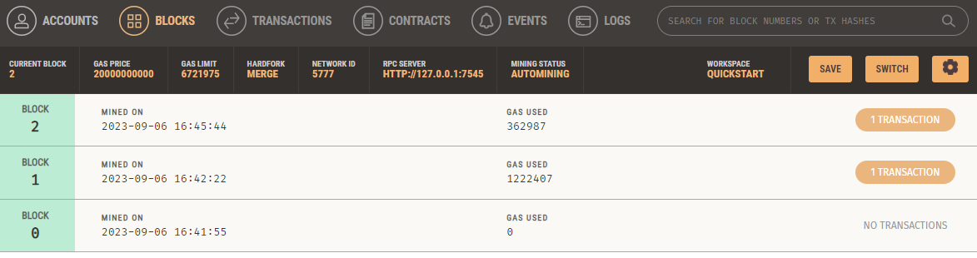
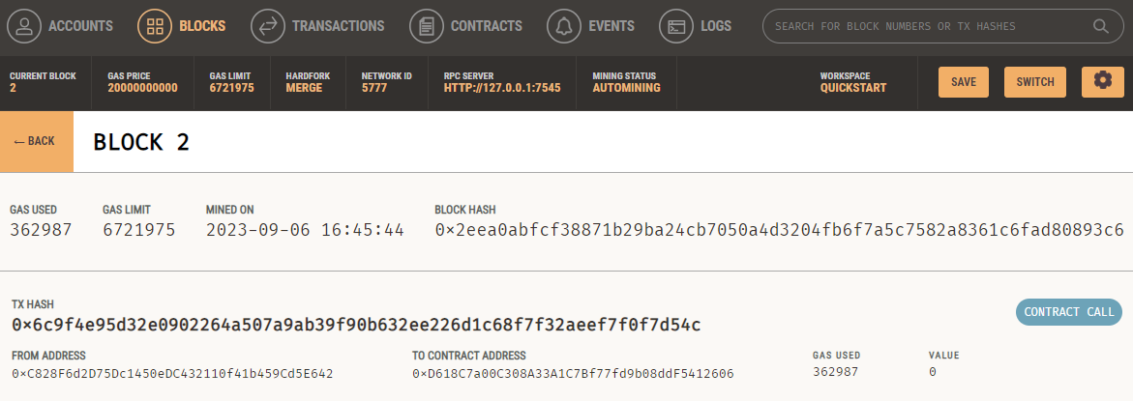
Progress up to Progress presentation - 02
IT 20150952 | [Brahanawardhan]

Slide 22
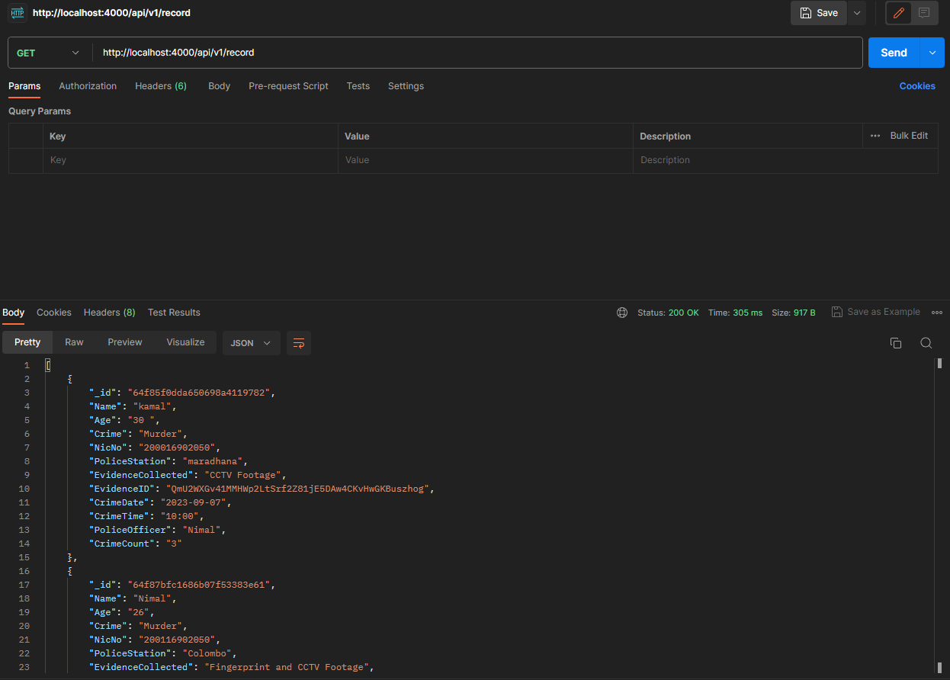
Progress up to Progress presentation - 02
IT 20150952 | [Brahanawardhan]

Slide 23
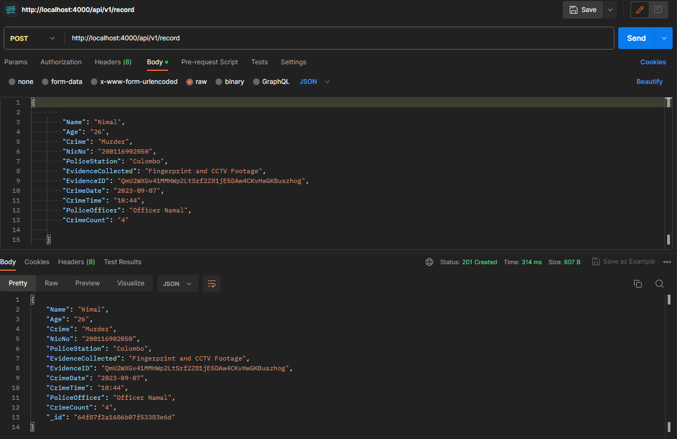
Progress up to Progress presentation - 02
IT 20150952 | [Brahanawardhan]

Slide 24

Demonstration
IT 20150952 | [Brahanawardhan]

Slide 25


Methodology
IDE : Remix (Ethereum) IDE, VS Code
Programming Language: Solidity, JS
Front- end: React JS
Blockchain Platform: Ganache Personal Blockchain (Truffle Suite)
Project Management : Trello, Ms Planner
IT 20150952 | [Brahanawardhan]

Slide 26

Pending Works
Input Validation for Criminal information entry form.
Design modification for Front-end development.
Integrated with final Product.
IT 20150952 | [Brahanawardhan]

Slide 27
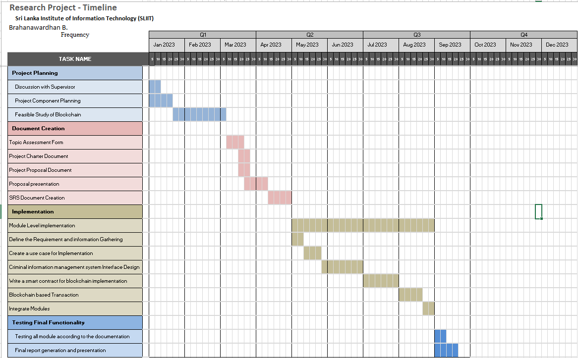
Gantt Chart
IT 20150952 | [Brahanawardhan]

Slide 28
References
“Blockchain-based Criminal Record Database Management.” [Online]. Available: https://ieeexplore.ieee.org/document/9544655. [Accessed: 19-Mar-2023].
“Crab: Blockchain based Criminal Record Management System.” [Online]. Available: https://www.researchgate.net/publication/329489346_CRAB_Blockchain_Based_ Criminal_Record_Management_System. [Accessed: 19-Mar-2023].
“Blockchain-based Criminal Record Database Management.” [Online]. Available: https://ieeexplore.ieee.org/document/9544655. [Accessed: 19-Mar-2023].
Wust, K., Gipp, B., & Breitenbücher, U. (2018). “Blockchain in forensic science: Securing digital evidence”. In 2018 41st International Convention on Information and Communication Technology, Electronics and Microelectronics (MIPRO) (pp. 1350- 1355). IEEE.
IT 20150952 | [Brahanawardhan]

Slide 29
Authentication System
03
IT20171438 | WIJAYARATHNE S. N.
Specializing in Cyber Security

Slide 30





Research Question
How To Secure System Login By Implementing A Secure Authentication System To The Blockchain- Based Criminal Information Management System In Sri Lanka?
Is 2-Factor Authentication SECURE? Can 2-Factor Authentication be HACKED?
SIM Swapping
SIM Cloning
Man-in-the-Middle Attacks
Phishing Attacks
Social Engineering
IT20171438 | WIJAYARATHNE S. N.

Slide 31
Research Gap
CONSIDERATION ON | EXISTING SYSTEMS | PROPOSED SYSTEM
1ST FACTOR | Security Level is LOW | Security Level is HIGH
2ND FACTOR | Security Level is MODERATE | Security Level is HIGH
CONFIDENTIALITY | Security Level is LOW | Security Level is HIGH
INTEGRITY | Security Level is LOW | Security Level is HIGH
POSSIBLE OTP COMBINATIONS | LOW (59,049) | HIGH (60,466,176)
OVERALL SYSTEM | Security Level is MODERATE | Security Level is HIGH
IT20171438 | WIJAYARATHNE S. N.

Slide 32
Specific & Sub Objectives
Proposed Authentication System;
Two-Factor Authentication (2FA) System
Additional Layer of Security Implemented at the End.
The 1st Factor;
Username and Password
The 2nd Factor;
One-Time Password
Additional Layer of Security;
System Generated Unique Passcode
IT20171438 | WIJAYARATHNE S. N.

Slide 33
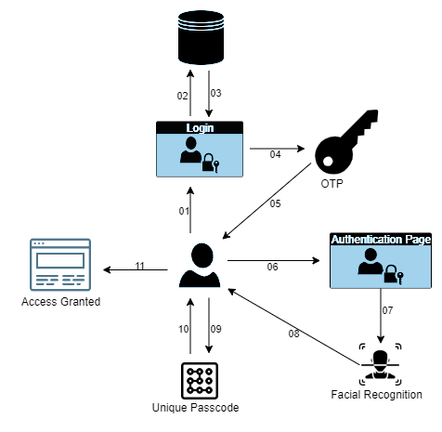
System Diagram
02
03
01 – User entering Username & Password
02 – Entered Username & Password being checked
03 – Username & Password being verified
04 – Moving to the OTP page
05 – OTP code will be send to the client
06 – Entering the OTP code to the Authentication Page
07 – User entering the Unique Passcode
08 – Verifying the Unique Passcode
09 – Access Granted to the System
04
01
05
09
06
08
07
IT20171438 | WIJAYARATHNE S. N.

Slide 34
System Description
1st Factor;
Highest-level of Security Standards
Alerts Generated
Number of Attempts
2nd Factor;
6-Digit Code → 6-Character Code [59,049 → 60,466,176]
Number of Attempts
Time Restriction
Additional Layer of Security;
Unique System Generated Code
Code Expiration
IT20171438 | WIJAYARATHNE S. N.

Slide 35
Requirements
Functional Requirements
Non-Functional Requirements
User Registration
Factor Options
Factor Management
Authentication Workflow
Integration with Applications
Authentication Logging
Security
Performance
Reliability
Usability
Scalability
Compliance
IT20171438 | WIJAYARATHNE S. N.

Slide 36

Layouts
IT20171438 | WIJAYARATHNE S. N.

Slide 37
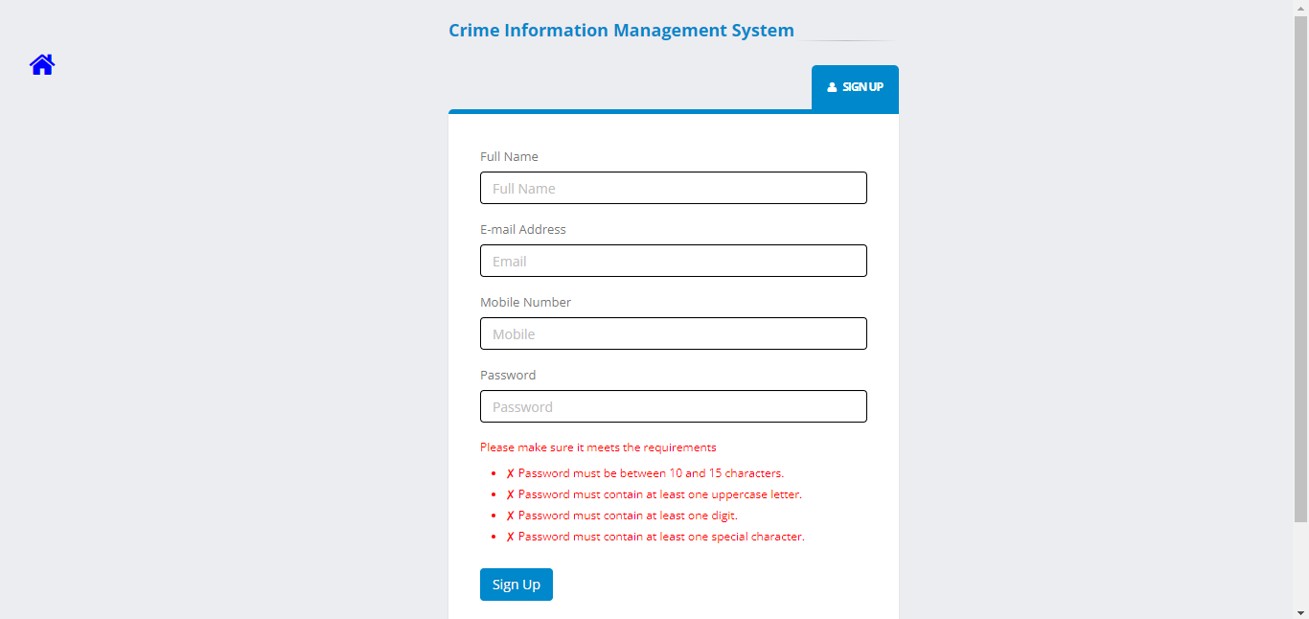
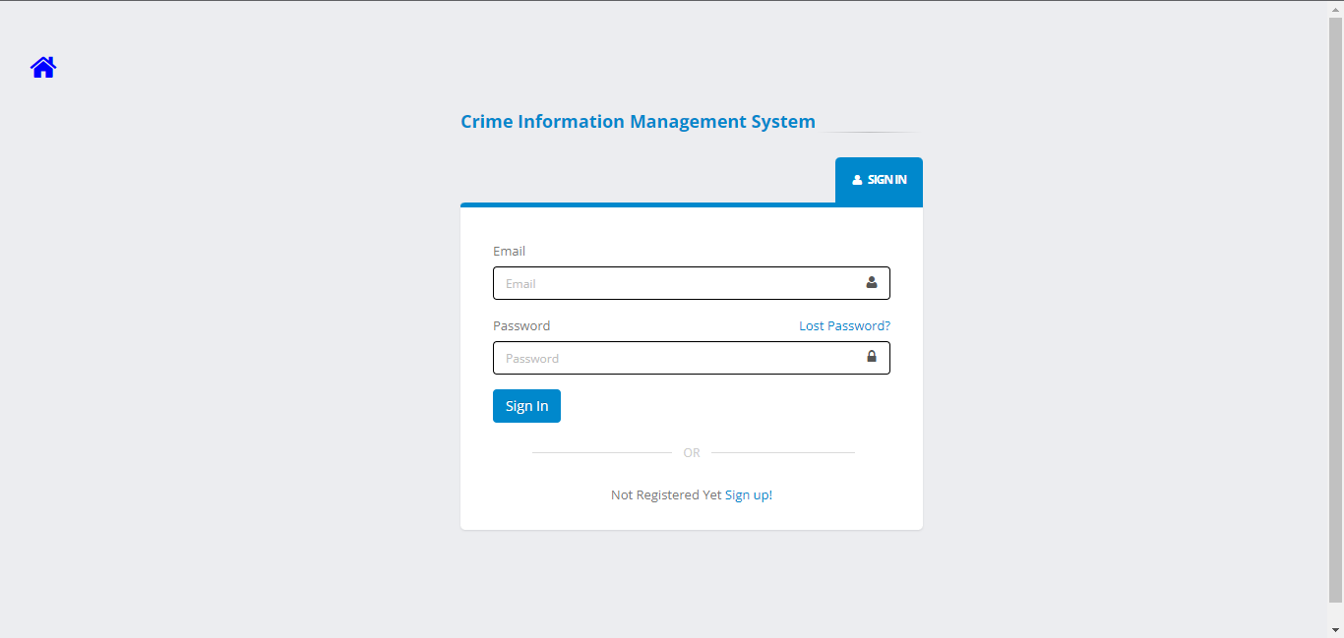
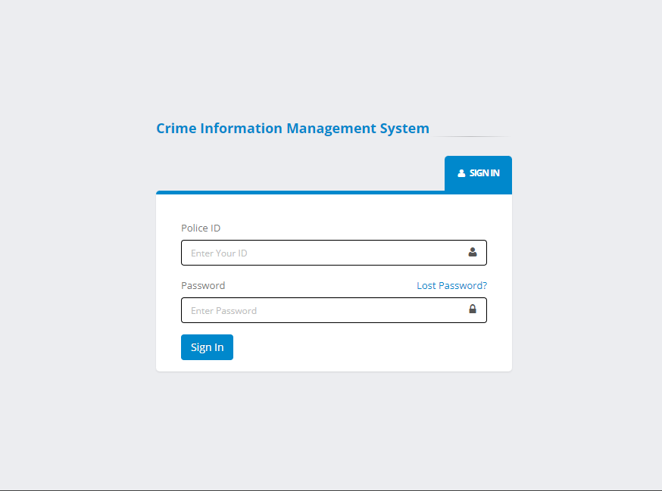
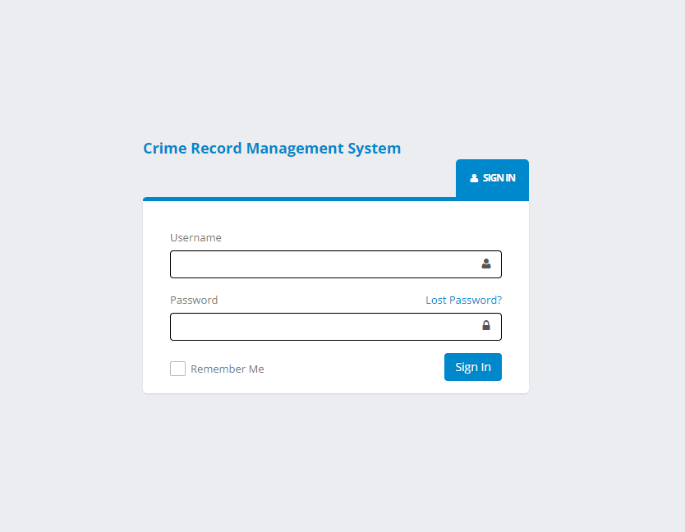
Layouts
IT20171438 | WIJAYARATHNE S. N.

Slide 38
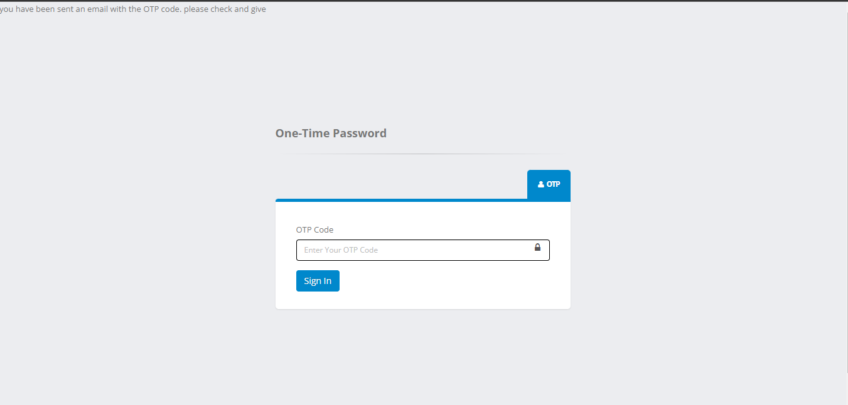
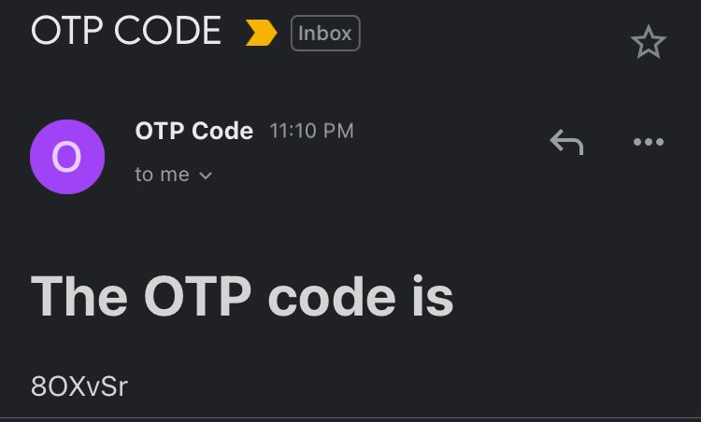
Layouts
IT20171438 | WIJAYARATHNE S. N.

Slide 39
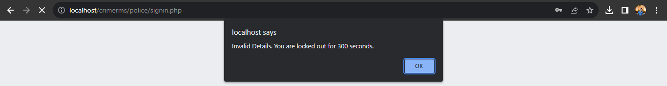
Layouts
IT20171438 | WIJAYARATHNE S. N.

Slide 40
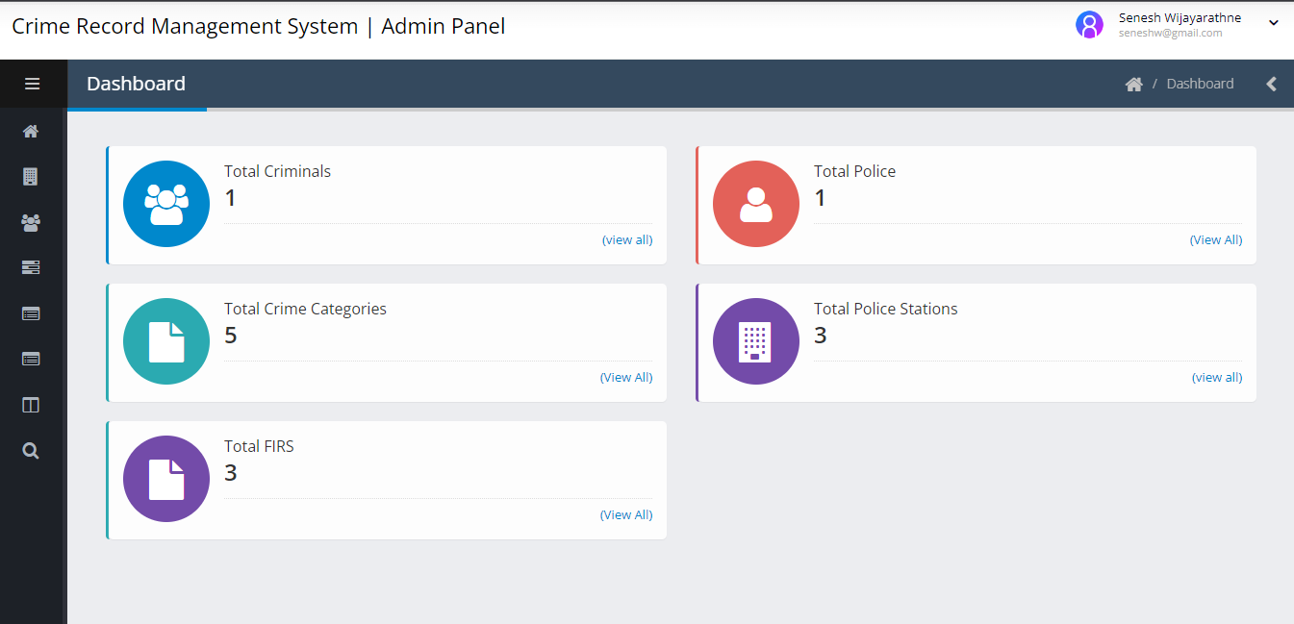
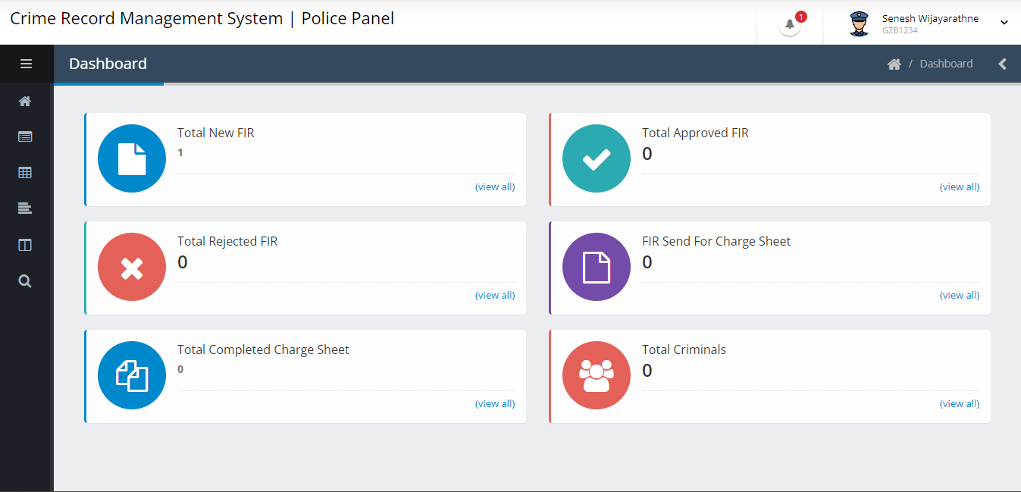
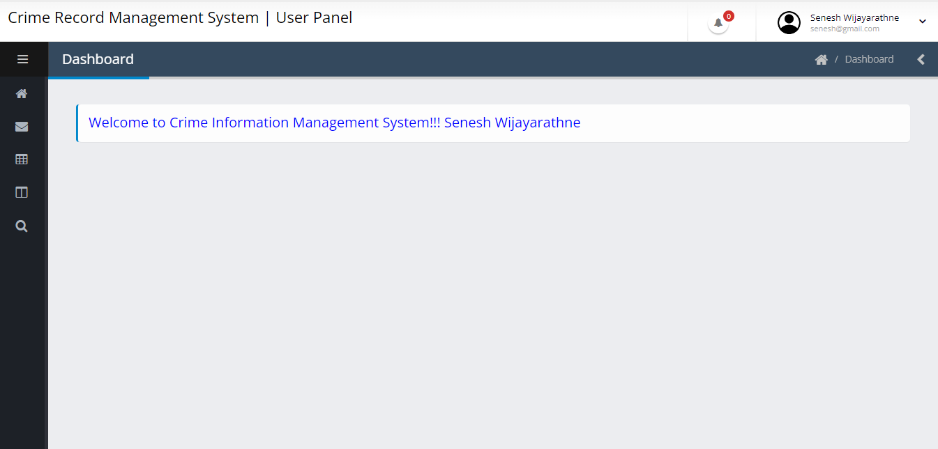
Layouts
IT20171438 | WIJAYARATHNE S. N.

Slide 41
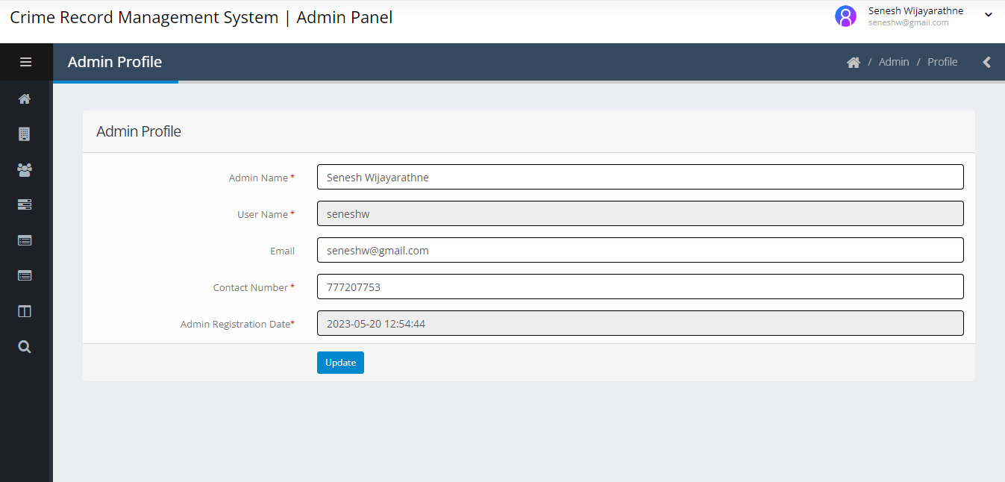
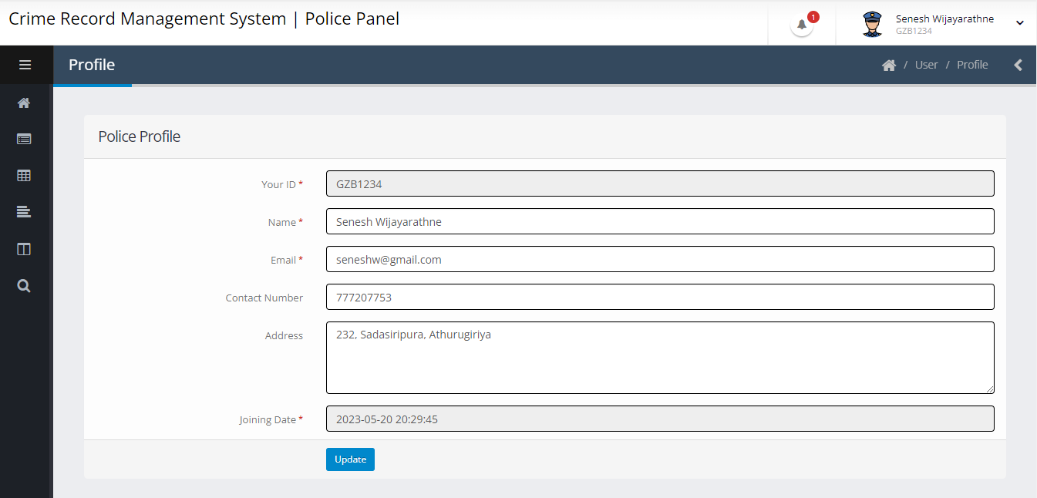
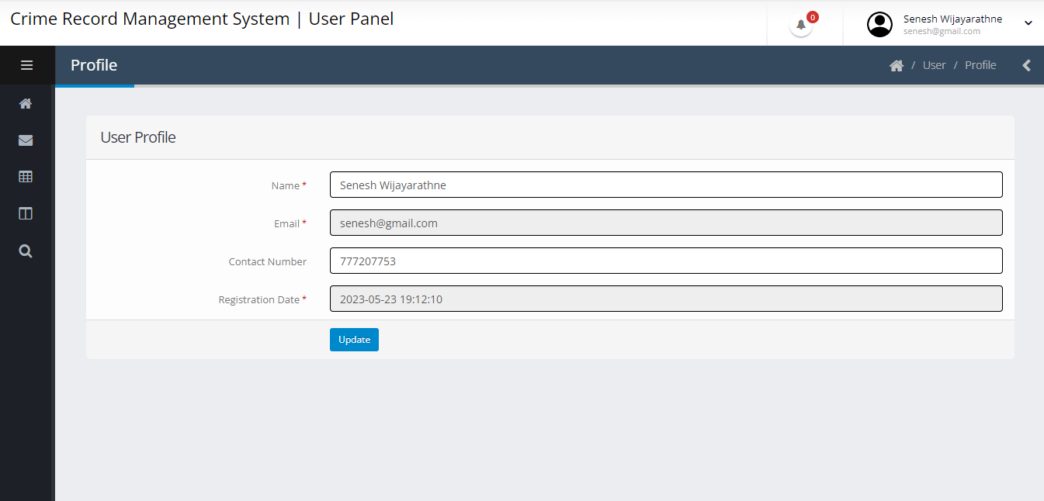
Layouts
IT20171438 | WIJAYARATHNE S. N.

Slide 42
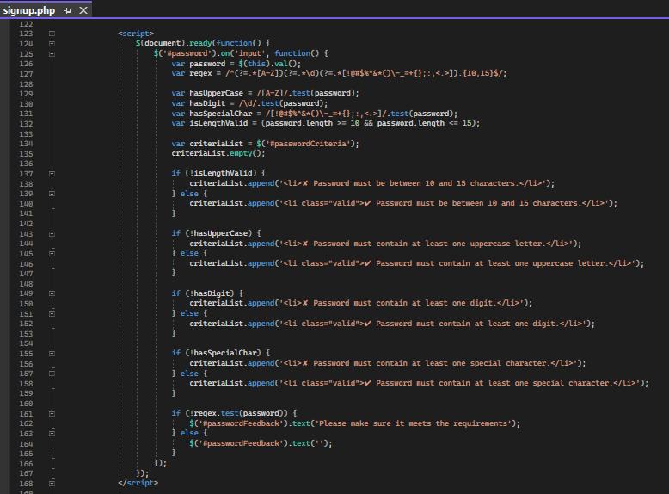
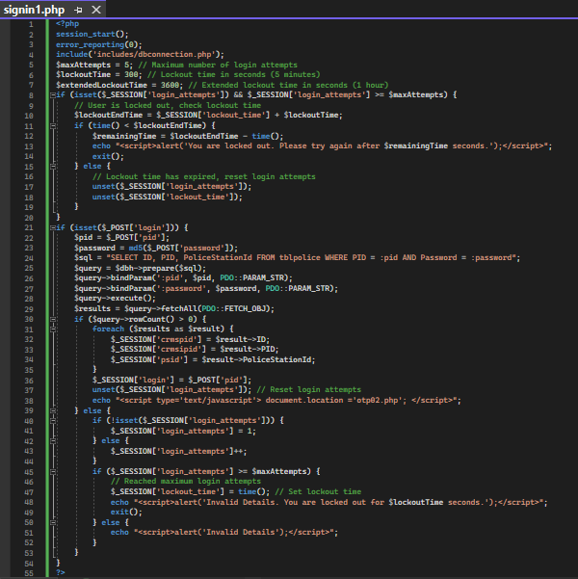
Backend
IT20171438 | WIJAYARATHNE S. N.

Slide 43
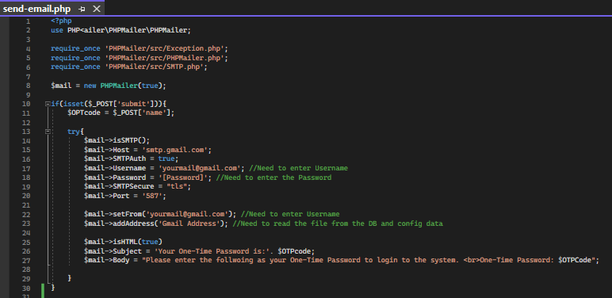
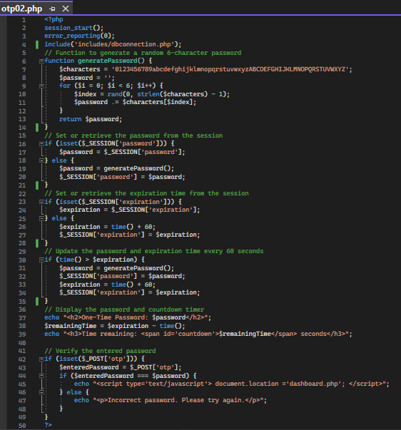
Backend
IT20171438 | WIJAYARATHNE S. N.

Slide 44
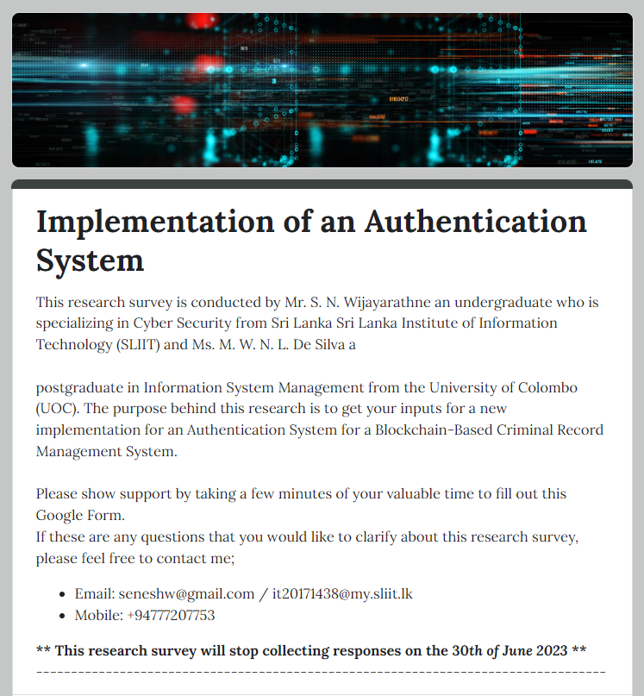
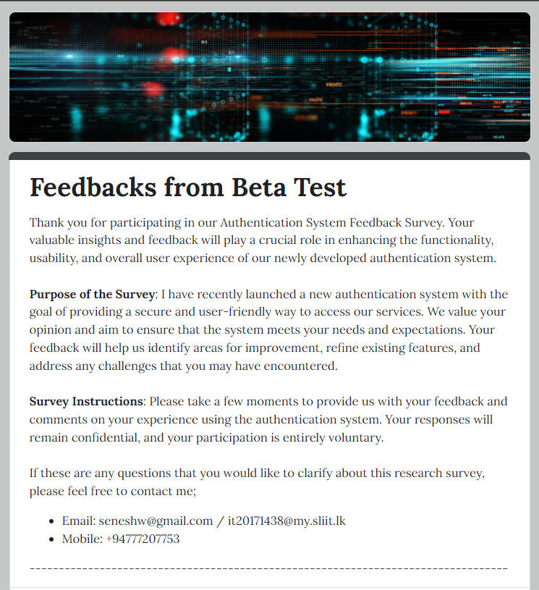
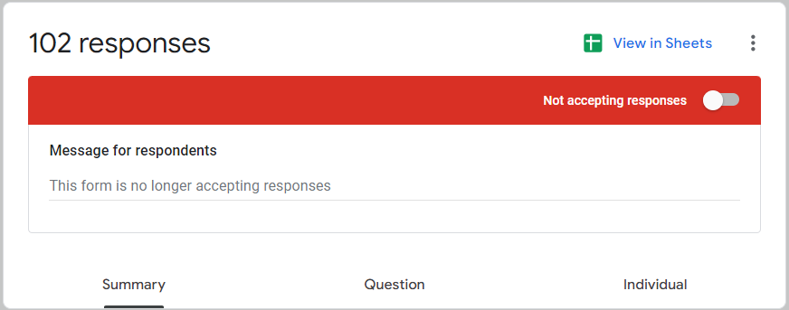
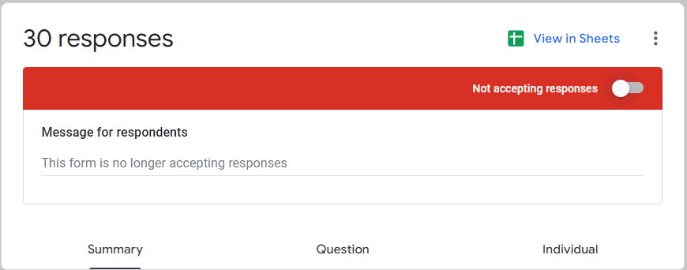
Supportive Research
IT20171438 | WIJAYARATHNE S. N.

Slide 45
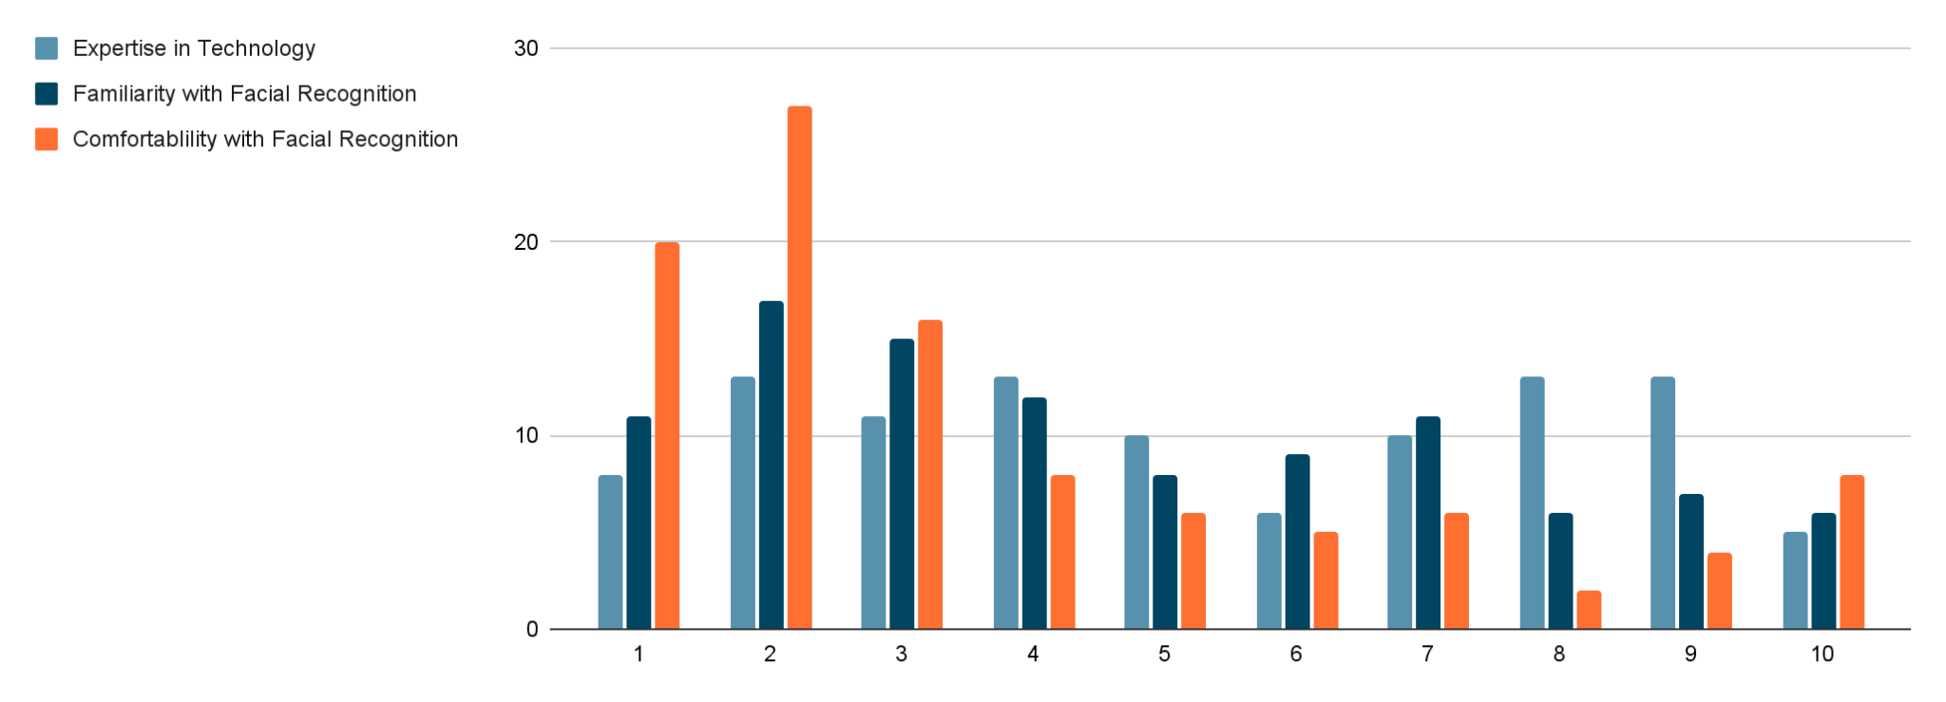
Supportive Research [Implementation]
Expertise in Technology 1: Rookie, 10: Expert
Familiarity with Facial Recognition 1: Rookie, 10: Expert
Comfortability with Facial Recognition
1: Not Comfortable, 10: Highly Comfortable
IT20171438 | WIJAYARATHNE S. N.

Slide 46
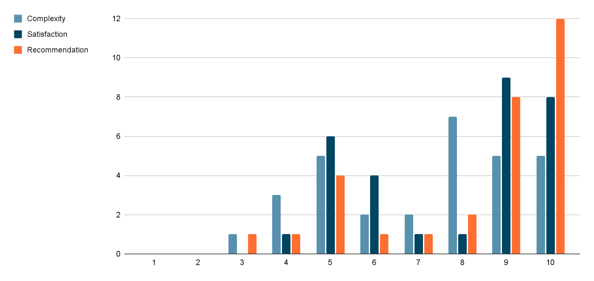
Supportive Research [Beta Test]
Complexity 1: Complicated, 10: Straightforward
Satisfaction 1: Unsatisfied, 10: Highly Satisfied
Recommendation
1: Not Comfortable, 10: Highly Comfortable
IT20171438 | WIJAYARATHNE S. N.

Slide 47

Demonstration
[Video]
IT20171438 | WIJAYARATHNE S. N.

Slide 48
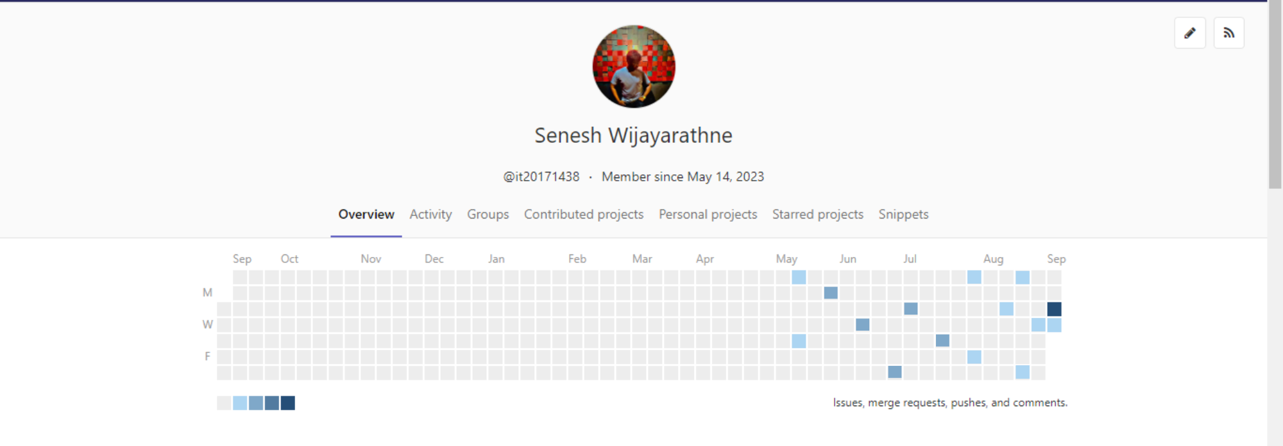
GitLab Updates
IT20171438 | WIJAYARATHNE S. N.

Slide 49
Pending Work
Dissertation Report Completion
System Integrations
Dissertation Proofreading
Final System Check
Additional Layer
Final Presentation
IT20171438 | WIJAYARATHNE S. N.

Slide 50
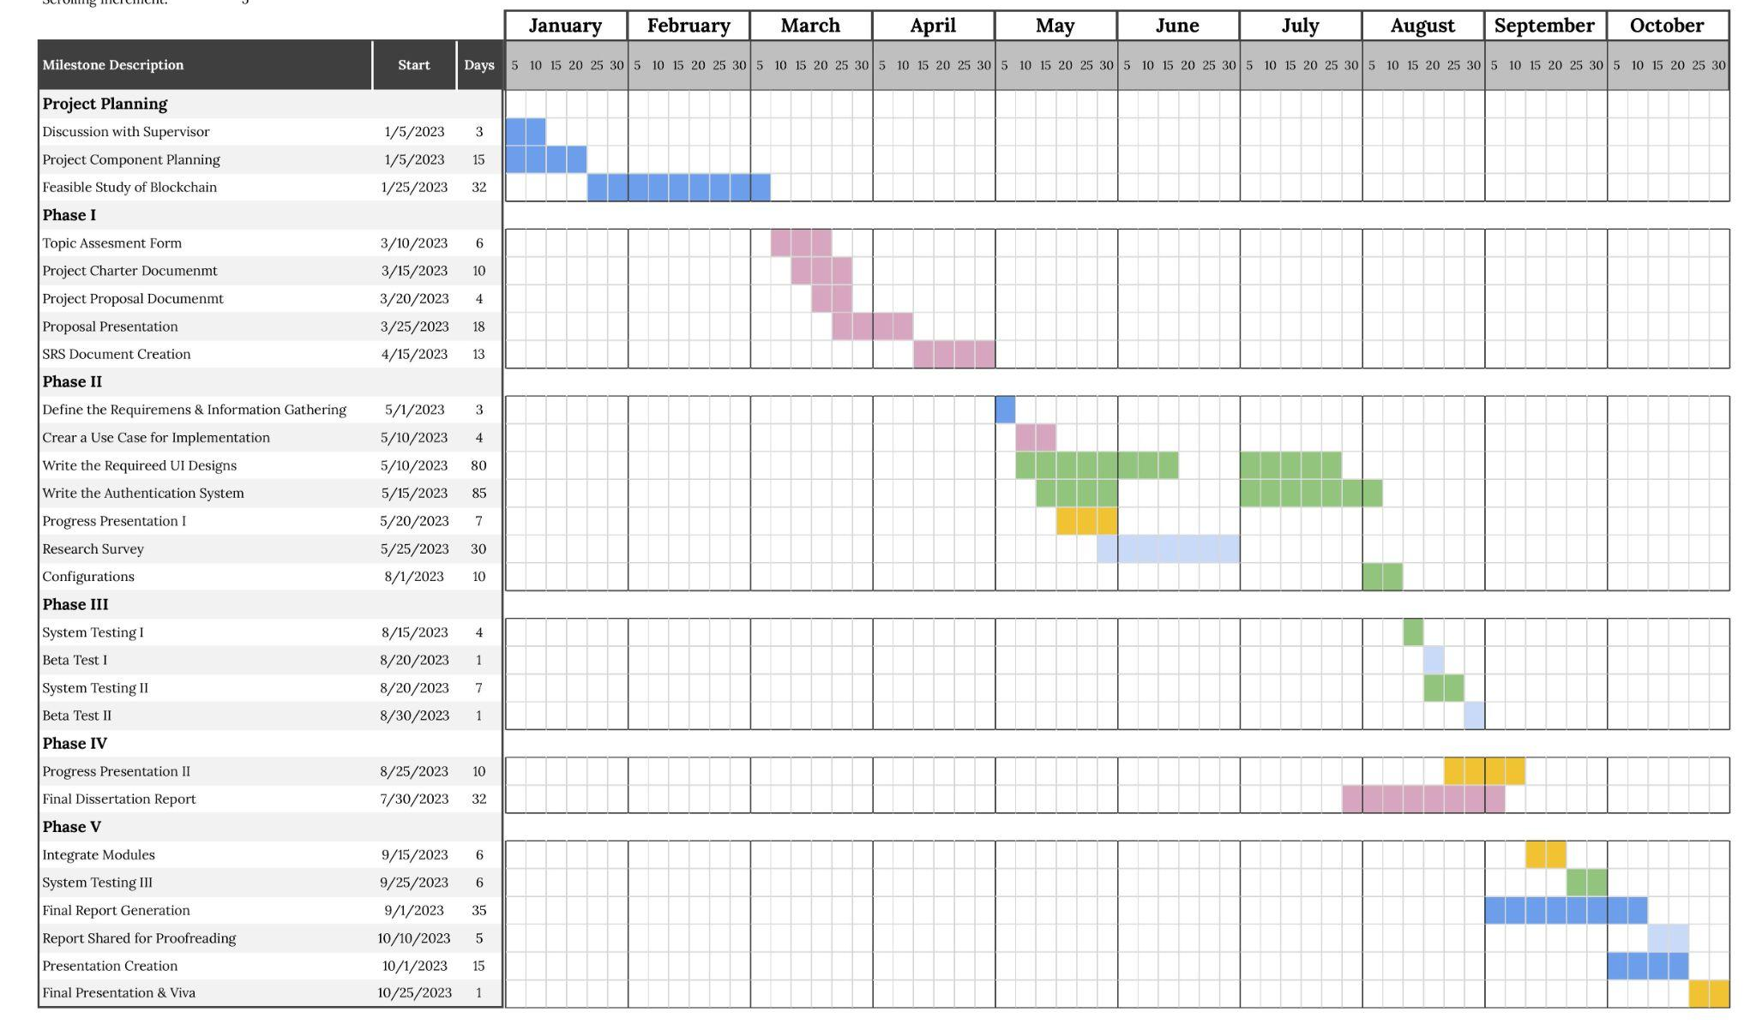
Gantt Chart
Gantt Chart: It20171438
IT20171438 | WIJAYARATHNE S. N.

Slide 51
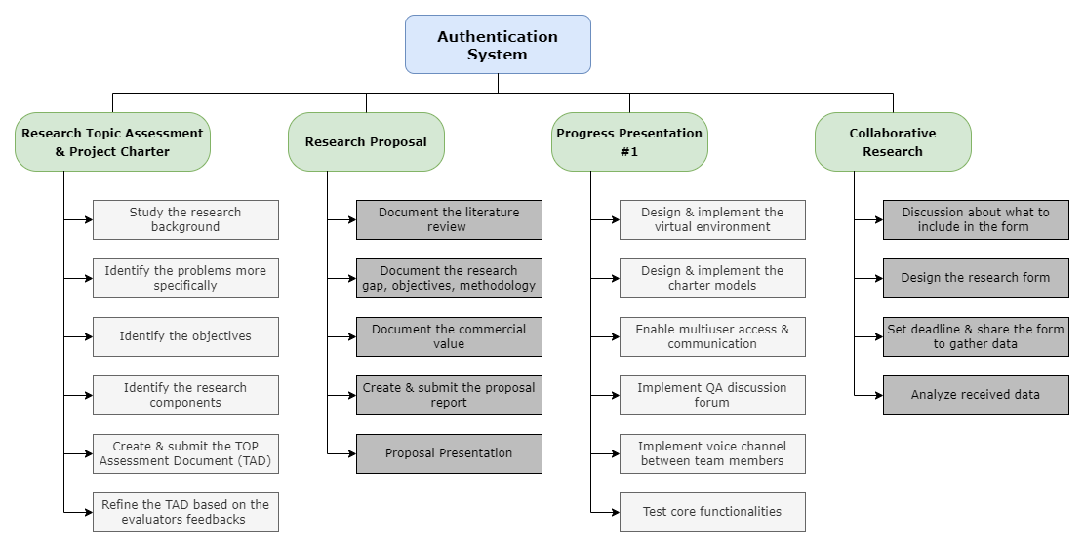
Work Breakdown
#01
IT20171438 | WIJAYARATHNE S. N.

Slide 52
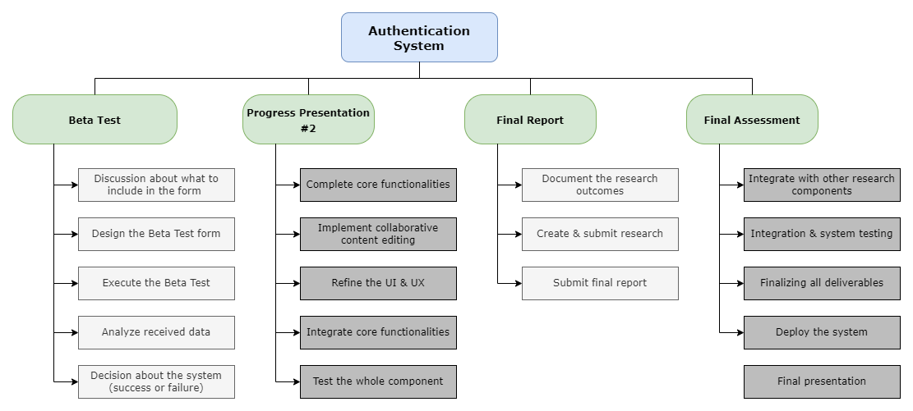
Work Breakdown
#02
IT20171438 | WIJAYARATHNE S. N.

Slide 53
Upcoming Schedule
Month: September
M
T
W
T
F
S
S
Week 1
28
29
30
31
01
02
03
PROGRESS PRESENTATION II PREPARATION
Week 2
04
05
06
07
08
09
10
PROGRESS PRESENTATION II
INTEGRATE
Week 3
11
12
13
14
15
16
17
MODULES
FINAL SYSTEM TESTING
Week 4
18
19
20
21
22
23
24
FINAL REPORT GENERATION
Week 5
25
26
27
28
29
30
01
FINAL REPORT GENERATION
IT20171438 | WIJAYARATHNE S. N.

Slide 54
Upcoming Schedule
Month: October
M
T
W
T
F
S
S
Week 1
02
03
04
05
06
07
08
REPORT SHARED FOR PROOFREADING
Week 2
09
10
11
12
13
14
15
FINAL PRESENTATION CREATING
Week 3
16
17
18
19
20
21
22
FINAL PRESENTATION PREPARATION
Week 4
23
24
25
26
27
28
29
FINAL PRESENTATION
Week 5
30
31
01
02
03
04
05
& VIVA
IT20171438 | WIJAYARATHNE S. N.

Slide 55
References
R. P. Jover, "Security analysis of SMS as a second factor of authentication," Commun. ACM, vol. 63, no. 12, p. 46–52, 17 November 2020, doi: doi.org/10.1145/3424260.
V. Papaspirou, L. Maglaras, M. A. Ferrag, I. Kantzavelou, H. Janicke and C. Douligeris, "A novel Two-Factor HoneyToken Authentication Mechanism," 2021 International Conference on Computer Communications and Networks (ICCCN), Athens, Greece, 2021, pp. 1-7, doi: 10.1109/ICCCN52240.2021.9522319.
Konoth, R.K., van der Veen, V., Bos, H. (2017). How Anywhere Computing Just Killed Your Phone-Based Two-Factor Authentication. In: Grossklags, J., Preneel, B. (eds) Financial Cryptography and Data Security. FC 2016. Lecture Notes in Computer Science, vol 9603. Springer, Berlin, Heidelberg. https://doi.org/10.1007/978-3-662-54970-4_24
Adham, M., Azodi, A., Desmedt, Y., Karaolis, I. (2013). How to Attack Two-Factor Authentication Internet Banking. In: Sadeghi, AR. (eds) Financial Cryptography and Data Security. FC 2013. Lecture Notes in Computer Science, vol 7859. Springer, Berlin, Heidelberg. https://doi.org/10.1007/978-3-642-39884-1
IT20171438 | WIJAYARATHNE S. N.

Slide 56
Secure File Management System
04
IT20157814 | M.N H AHMED
Specializing in Cyber Security

Slide 57
Sub Objective
Secure File Management System in Decentralized Network
Implementing cryptography secure file management system to share file.
Implementing cryptography secure file management system to store file.
IT20157814 | M.N.H AHMED

Slide 58
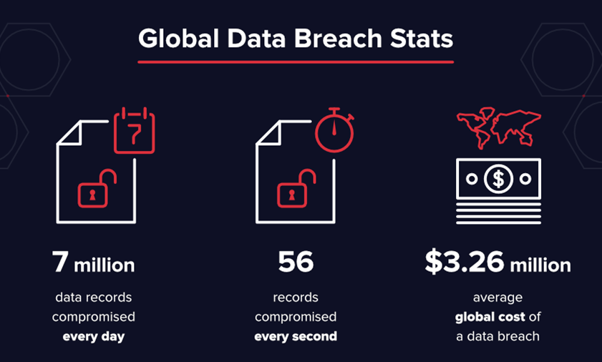
Research Problem
Manual file sharing system
Paper based
Store files in cupboard and etc
Centralize System
Sorting files in a single database without proper encryption
Data Breach
Vulnerabilities in Current file management system
SQL Injection Attack
DDoS Attack
Theft / Stolen of the Files
IT20157814 | M.N.H AHMED

Slide 59
Objective Achieved
To provide secure storage platform for criminal information management system.
Ensure Confidentiality, Integrity, Availability.
Increase the performance and usability of criminal Records.
Implementing cryptography secure file management system to share file.
Implementing cryptography secure file management system to store file.
IT20157814 | M.N.H AHMED

Slide 60
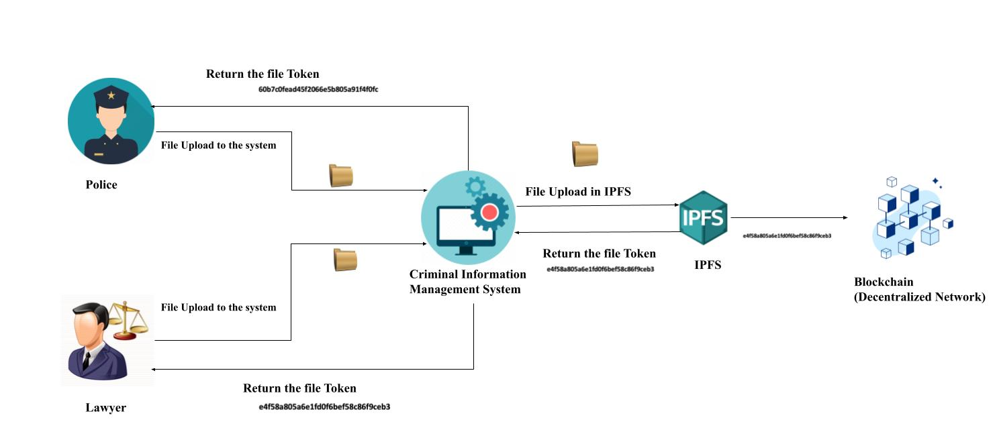
System Diagram
Secure File Management System in Decentralized Network
IT20157814 | M.N.H AHMED

Slide 61
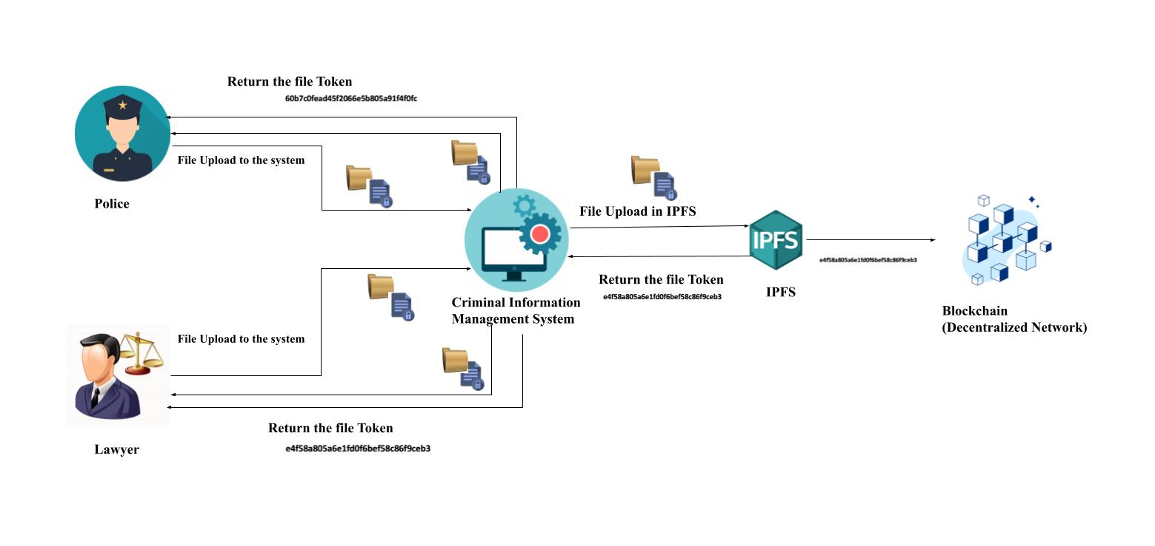
System Diagram
Implementing Cryptography Secure File Management System to Store File
IT20157814 | M.N.H AHMED

Slide 62
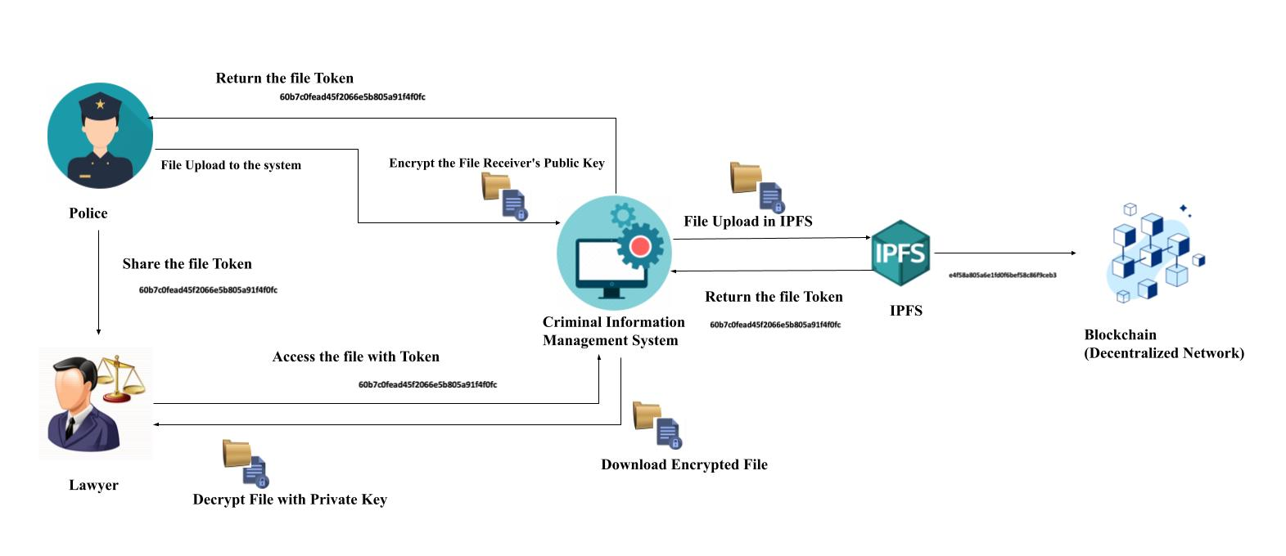
System Diagram
Implementing Cryptography Secure File Management System to Share File
IT20157814 | M.N.H AHMED

Slide 63
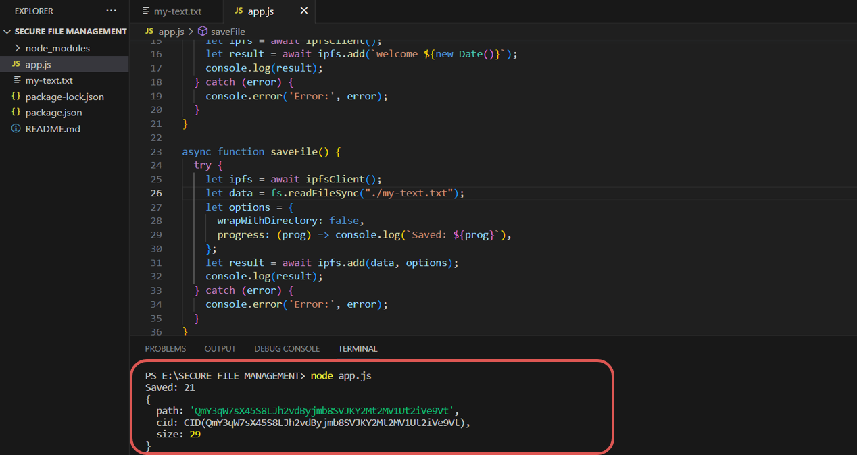
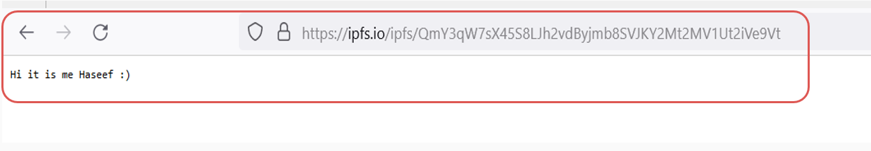
Progress up to Progress presentation - 01
File Upload to IPFS
IT20157814 | M.N.H AHMED

Slide 64
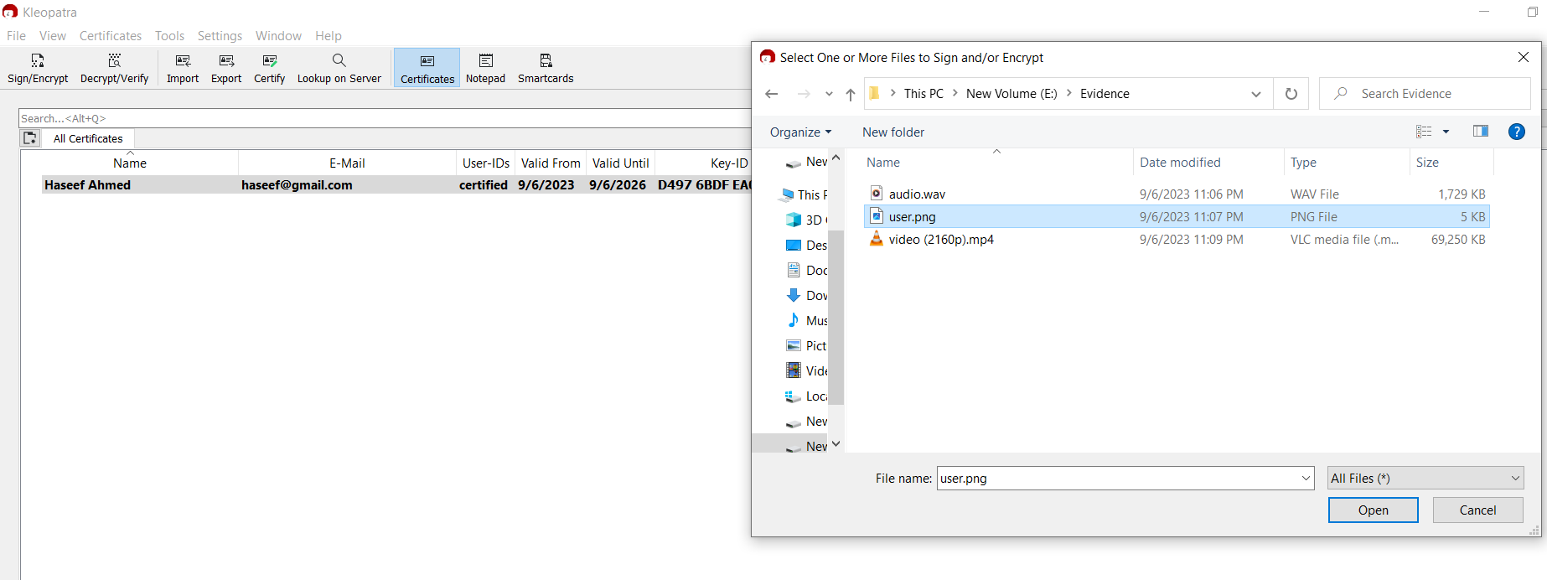
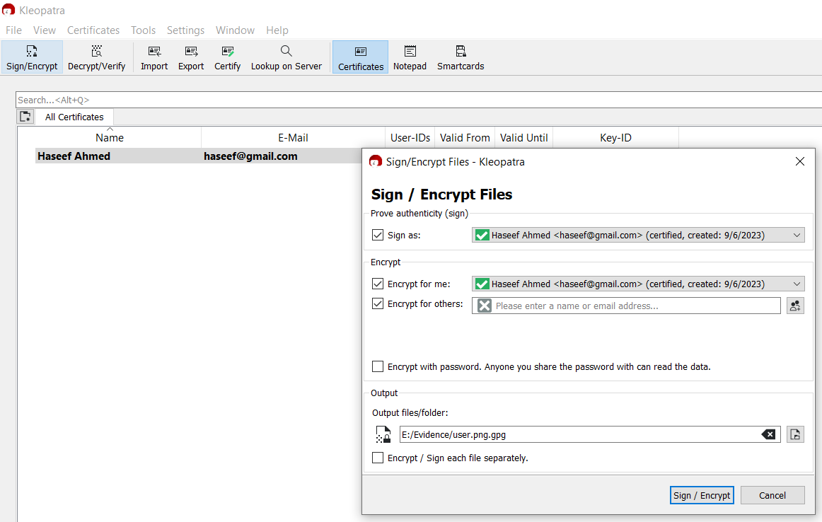
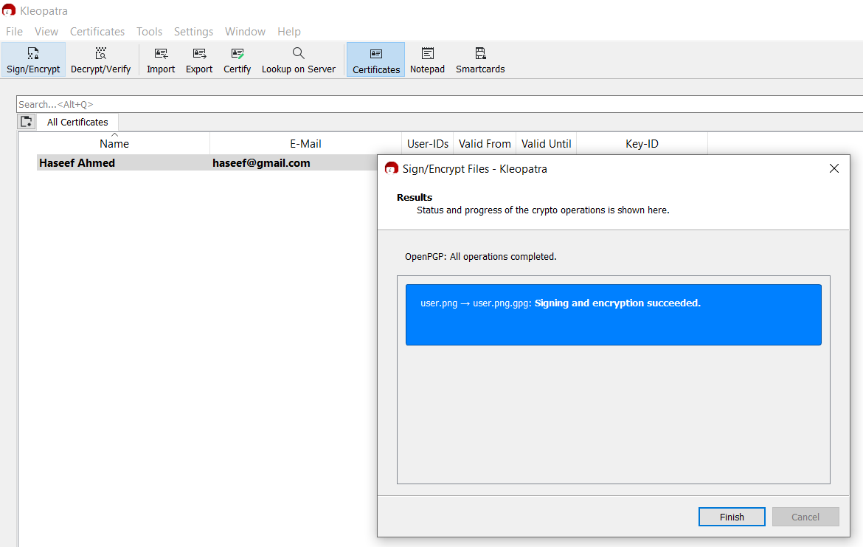
Progress up to Progress presentation - 02
Encryption & Decryption of the file
IT20157814 | M.N.H AHMED

Slide 65


Progress up to Progress presentation - 02
Encryption & Decryption of the file
IT20157814 | M.N.H AHMED

Slide 66

Progress up to Progress presentation - 02
Integrate frontend with IPFS
File Upload to IPFS
IT20157814 | M.N.H AHMED

Slide 67

Progress up to Progress presentation - 02
File Download from IPFS
IT20157814 | M.N.H AHMED

Slide 68

Progress up to Progress presentation - 02
File Integrity Check
Uploaded File Hash
Download File Hash
IT20157814 | M.N.H AHMED

Slide 69


Progress up to Progress presentation - 02
Sending CID value to Blockchain
IT20157814 | M.N.H AHMED

Slide 70
Methodology
IDE : VS Code
Programming Language: JavaScript, HTML, CSS
File Management: InterPlanetary File System (IPFS)
Blockchain Platform: Ganache Personal Blockchain (Truffle Suite)
Project Management : Trello, Ms Planner
Encryption & Decryption : Klopatra (GnuPG)
IT20157814 | M.N.H AHMED

Slide 71
Pending Work
Dissertation Report Completion
System Integrations
Dissertation Proofreading
Final System Check
System Website
Final Presentation
IT20157814 | M.N.H AHMED

Slide 72

Gantt Chart
IT20157814 | M.N.H AHMED

Slide 73
Upcoming Schedule
Month: September
M
T
W
T
F
S
S
Week 1
28
29
30
31
01
02
03
PROGRESS PRESENTATION II PREPARATION
Week 2
04
05
06
07
08
09
10
PROGRESS PRESENTATION II
INTEGRATE
Week 3
11
12
13
14
15
16
17
MODULES
FINAL SYSTEM TESTING
Week 4
18
19
20
21
22
23
24
FINAL REPORT GENERATION
Week 5
25
26
27
28
29
30
01
FINAL REPORT GENERATION
IT20157814 | M.N.H AHMED

Slide 74
Upcoming Schedule
Month: October
M
T
W
T
F
S
S
Week 1
02
03
04
05
06
07
08
REPORT SHARED FOR PROOFREADING
Week 2
09
10
11
12
13
14
15
FINAL PRESENTATION CREATING
Week 3
16
17
18
19
20
21
22
FINAL PRESENTATION PREPARATION
Week 4
23
24
25
26
27
28
29
FINAL PRESENTATION
Week 5
30
31
01
02
03
04
05
& VIVA
IT20157814 | M.N.H AHMED

Slide 75
References
E. Onuiri, A. Oludele, O. Olufunmike and S. Oluwawunmi , "A REAL-TIME CRIME RECORDS MANAGEMENT SYSTEM FOR NATIONAL SECURITY AGENCIES," May 2015. [Online]. Available: https://www.researchgate.net/publication/305426207_A_REAL-TIME_CRIME_RECORDS_MANAGEMENT_SYSTEM_FOR_NATIONAL_SECURITY_AGENCIES. [Accessed 20 March 2023].
A. Jain, S. Das, A. Singh Kushwah, T. Rajora and S. Saboo, "Blockchain-Based Criminal Record Database Management," 2021 Asian Conference on Innovation in Technology (ASIANCON), PUNE, India, 2021, pp. 1-5, doi: 10.1109/ASIANCON51346.2021.9544655.
S. Reno, S. Bhowmik and M. Ahmed, "Utilizing IPFS and Private Blockchain to Secure Forensic Information," 2021 International Conference on Automation, Control and Mechatronics for Industry 4.0 (ACMI), Rajshahi, Bangladesh, 2021, pp. 1-6, doi: 10.1109/ACMI53878.2021.9528180.
T.-S. C. J.-Y. W. Hsiao-Shan Huang, "A Secure File Sharing System Based on IPFS and Blockchain," 02 May 2022. [Online]. Available: https://arxiv.org/abs/2205.01728. [Accessed 20 March 2023]
D. Praveen, S. G. Totad, M. Rashinkar, R. Ostwal, S. Patil and P. M. Hadapad, "Scalable Blockchain Architecture using off-chain IPFS for Marks Card Validation," in 4th International Conference on Innovative Data Communication Technology and Application, 2022.
IT20157814 | M.N.H AHMED

Slide 76
Demonstration
IT20157814 | M.N.H AHMED

Slide 77
Implementing Chain Of Custody Evidence Management
05
IT19983370 | THUSHITHARAN .M
Specializing in Cyber Security

Slide 78

Chain of Custody
Chain of Custody of more than a system, This is a Process of handling the movement of evidences by the Department of Police Sri Lanka
How can the implementation of chain of custody in of the criminal records management improve the current Process of handling the evidenece?
Chain of custody is a logical sequence of keep the records of digital evidence process.
Once peer uploads the file, the file is stored in a ipfs.
These block gets appended to the current blockchain, which makes it impossible to edit or delete the file/block.
IT19983370 | Thushitharan M

Slide 79
Current System Followed by Sri Lankan Police Department - The Research Problem
Evidence are not stored in a proper manner.
Digital evidences are stored locally in the police station computer’s hard drive which is completely insecure.
Any authorized officials can access the digital evidence by just signing in the log ledger. This may let them delete other’s evidence without their concern and there will be no records of who deleted the evidence file.
Not aware of the Chain of Custody process.
Lack of knowledge in digitalize the physical evidence.
IT19983370 | Thushitharan M

Slide 80
Objective Achieved
Storing the Evidences details in the database.
Ensure Confidentiality, Integrity(By checking Hashes of the downloaded file), Availability(always available to download once the user got logged in to the system)
Increased efficiency, availability.
IT19983370 | Thushitharan M

Slide 81

Chain of Custody Process Diagram
Chain of Custody
IT19983370 | Thushitharan M

Slide 82

Progress up to Progress presentation - 01
Before the File Upload
IT19983370 | Thushitharan M

Slide 83

Progress up to Progress presentation - 02
After the File Upload
IT19983370 | Thushitharan M

Slide 84

Progress up to Progress presentation - 02
Implement Evidence Movement Log Management System(upload)
IT19983370 | Thushitharan M

Slide 85

Progress up to Progress presentation - 02
Implement Criminal Records Entry Log Management System
IT19983370 | Thushitharan M

Slide 86
Overall Pending Work
Sub Component Integration within my component
Overall System Integrations
Dissertation Proofreading
Final System Check
System Website
Final Presentation
IT19983370 | Thushitharan M

Slide 87
Methodology
IDE : Visual Studio Code
Programming Language: HTML, CSS, Javascript, Php, Mysql
Server: Apache web Server
Project Management : Trello, MS Planner
Version Control: Gitlab
IT19983370 | Thushitharan M

Slide 88
Pending Development
Implement Download log storing Functionality
Evidence Log Filtering Functionality
Common UI Integration
Defining and Implementing Admin Level Access
Status of the evidence needs to be stored(Processing/Completed/Submitted to the court)
Overall Component Integration
Senesh Component - To check the current logged in user(staff) details
Branavan Component - To store the criminal record logs
Haseef Component - To store download/upload logs
IT19983370 | Thushitharan M

Slide 89
Progress Flow
Research on CoC
Phase 1: Development
Phase 3: Development
Despite being red, mars is actually a cold place
- Developed basic Chain of Custody System(to upload the evidence)
- This phase contains the minor functionalities as follows: filtering the evidences,
10%
35%
50%
75%
90%
100%
Planning
Phase 2: Development
Launch the Final Product
Plan what are the functionalities needs to be implemented to complete the component
- Development of the log management system
-the logs database should contain the log details of upload/download evidence, criminal records entry logs, system user activity logs
- User Training
- Getting feedbacks
- Bux Bixes
IT19983370 | Thushitharan M

Slide 90

Gantt Chart
IT19983370 | Thushitharan M

Slide 91
Upcoming Schedule
Month: September
M
T
W
T
F
S
S
Week 1
28
29
30
31
01
02
03
PROGRESS PRESENTATION II PREPARATION
Week 2
04
05
06
07
08
09
10
Progress Presentation II
Checking
Week 3
11
12
13
14
15
16
17
Input Validations
Integration within my Component
Week 4
18
19
20
21
22
23
24
Whole System Integration
Week 5
25
26
27
28
29
30
01
Whole System Integration
IT19983370 | Thushitharan M

Slide 92
Upcoming Schedule
Month: October
M
T
W
T
F
S
S
Week 1
02
03
04
05
06
07
08
Report Shared for Proofreading
Week 2
09
10
11
12
13
14
15
Testing the final Product and Bux Fixes
Week 3
16
17
18
19
20
21
22
Final Presentation Preparation
Week 4
23
24
25
26
27
28
29
Final Presentation Preparation
Final Presentation
Week 5
30
31
01
02
03
04
05
& VIVA
IT19983370 | Thushitharan M

Slide 93
References
Prayudi, Yudi & Sn, Azhari. (2015). Digital Chain of Custody: State of The Art. International Journal of Computer Applications. 114. 975-8887. 10.5120/19971-1856..
Anderson, G.S., Litzenberger, R. and Plecas, D. (2002), "Physical evidence of police officer stress", Policing: An International Journal, Vol. 25 No. 2, pp. 399-420.
Tasnim, Maisha & Omar, Abdullah & Rahman, Shahriar & Bhuiyan, Md. (2018). CRAB: Blockchain Based Criminal Record Management System. 294-303. 10.1007/978-3-030-05345-1_25.
IT19983370 | Thushitharan M

Slide 94


Supervisor & Co-Supervisor
Mr. Kanishka Yapa
Supervisor
Ms. Dinithi Pandithage
Co-Supervisor

Slide 95
Group Members
IT20150952
Brahanawadhan B.
IT20171438
Wijayarathne S.N.
IT20157814
Ahmed M.N.H.
IT19983370
Thushitharan M.
GROUP ID: 23-270

Slide 96
THANK YOU!
it20150952@my.sliit.lk - Brahanawardhan B
it20171438@my.sliit.lk - Wijayarathne S. N
it20157814@my.sliit.lk - Ahmed M. N. H
it19983370@my.sliit.lk - Thushitharan M.
www.sites.google.com/view/criminal-crysis
-- GROUP ID: 23-270 --

